Slide 1


GMP Fiscal Year 2027 Rate Case
Case No. 26-0096-TF | Public Hearing & DPS Information Session
March 5, 2026

Slide 2

Schedule
GMP filed Rate Request on January 16, 2026
Discovery & Testimony through June 2026
Public Hearing on March 5, 2026
Technical hearing – June 2026
New rates would start October 1, 2026

Slide 3
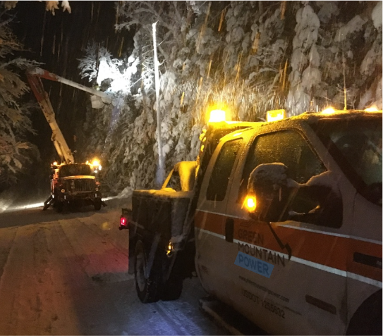

FY27 Rate Request Context
GMP filed for a 7.5% rate request
Power Supply & Transmission
  ISO-NE Transmission costs
  Wholesale energy and capacity prices
Inflationary pressures
  Materials, equipment, contractor services
  Labor and health care
  Property taxes
Escalating Storm Costs
  Unpredictable weather
  Storm frequency and severity increasing
  More than $100M in FY23-FY24 alone

Slide 4
How GMP is Responding
Continued operational discipline -- more than $160M in operational savings over the past decade
Savings for customers during peak energy times with flexible resources such as energy storage systems
  Saved $11M last year including $3M in one summer peak event alone
Reducing storm response costs through proactive resilience investments leading to reduced and shorter outages for customers

Slide 5
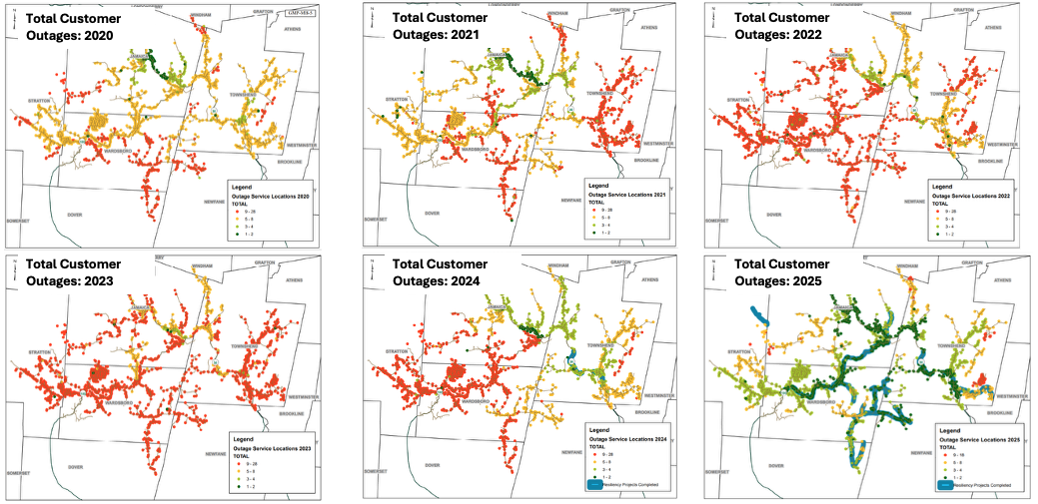
Resilience Results - Delivering for Customers
Moving from Reactive Storm Repair to Proactive Resilience
  Reducing storm response costs and improving reliability with undergrounding lines and storm hardening above ground lines
  FY27 Rate Request includes additional resilience projects building on success of current work

Slide 6
Thank you!

